Slide 1
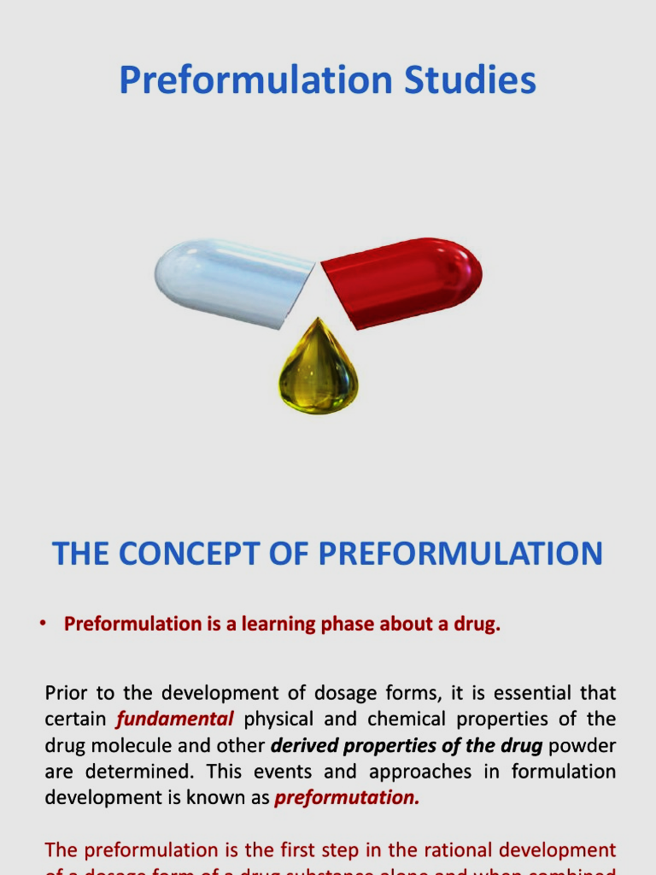
Pre-formulation Studies

Slide 2

Pre- Formulation
Preformulation is the initial stage in pharmaceutical development where the physicochemical properties of a new drug candidate are investigated
Preformulation studies may have a significant impact on manufacturing, storage, and performance of drug products. It not only helps to guide dosage form selection, but also provides insights into how drug products should be processed and stored to ensure their quality.

Slide 3

Objectives
To establish the Physico-Chemical parameters of a new drug entity.
To determine its kinetics and stability.
To establish its compatibility with common excipients.

Slide 4

major areas of pre-formulation research
Solubility Studies
pKa Determination
Bulk Characterization
Crystallinity and Amorphism
Stability Analysis
Solution Stability
pH Solubility Profile
Effect of Temperature
Solubilization
Partition Coefficient
Dissolution
Hygroscopicity
Micromeritic Properties
Solid State Stability
Drug-Excipient Compatibility

Slide 5

1.Solubility Studies
The solubility of a solid substance is defined as the concentration at which the solution phase is in equilibrium with a given solid phase at a stated temperature and pressure.
In order to be transported across biological membranes, drug molecules are required to be present in a dissolved form. Therefore, low aqueous solubility can delay or decrease drug absorption.
Knowledge of the solubility of a drug is also important during manufacturing of an injectable formulation or when direct administration into the blood stream is desired.
Poor aqueous solubility not only limits a drug’s biological application, but also challenges its pharmaceutical development.

Slide 6
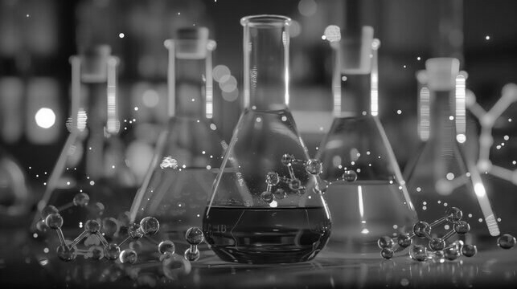
Solubility Studies
Descriptive term | Parts of Solvent required for 1 Part of Solute
Very soluble | Less than 1
Freely soluble | From 1 to 10
soluble | From 10 to 30
Sparingly soluble | From 30 to 100
Slightly soluble | From 100 to 1000
Very slightly soluble | From 1000 to 10000
Practically Insoluble | 10000 and over

Slide 7
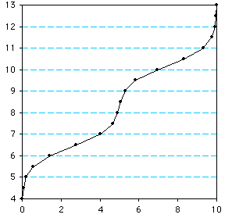
PKa Determinations
Determination of the dissociation constant for a drug capable of ionization within a pH range of 1 to 10 is important since solubility, and consequently absorption, can be altered by orders of magnitude with changing pH. The Henderson-Hasselbalch equation provides an estimate of the ionized and unionized drug concentration at a particular pH.
In general, the un-ionized drug molecule is the species absorbed from the gastrointestinal tract; however, rate of dissolution, lipid solubility, commonion effects, and metabolism in the GI tract can shift or reverse predictions of the extent and site of absorption based on pH alone.

Slide 8

PKa Determinations
Some reported methods for the determination of pKa
Potentiometric titration
UV spectroscopy
Solubility measurement
HPLC techniques
Capillary zone electrophoresis
Foaming activity

Slide 9
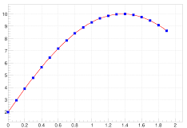
pH-Solubility Profile
The solubility of an acidic or basic drug depends on the pKa of the ionizing functional group and the intrinsic solubilities for both the ionized and unionized forms.

Slide 10
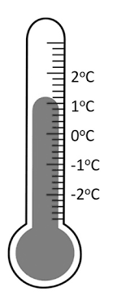
Effect of Temperature
The heat of solution, ΔHS , represents the heat released or absorbed when a mole of solute is dissolved in a large quantity of solvent.
Most commonly, the solution process is endothermic, or ΔHS is positive, and thus increasing the solution temperature increases the drug solubility.

Slide 11

Solubilization
For drug candidates with either poor water solubility or insufficient solubility for projected solution dosage forms, pre-formulation studies should include limited experiments to identify the possible mechanisms for solubilization.
The extent of solubilization due to the addition of cosolvent depends on the chemical structure of the drug, that is, the more non-polar the solute, the greater is the solubilization achieved by cosolvent addition.

Slide 12
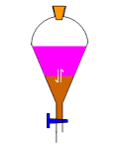
Partition Coefficient
A measurement of a drug’s lipophilicity and an indication of its ability to cross cell membranes is the oil/water partition coefficient. The partition coefficient, log P, is defined as the ratio of un-ionized drug distributed between the organic and aqueous phases at equilibrium.
The most common method for determining partition and distribution coefficients is the shake flask method.
For drug delivery, the lipophilic/hydrophilic balance has been shown to be a contributing factor for the rate and extent of drug absorption. Although partition coefficient data alone does not provide understanding of in vivo absorption, it does provide a means of characterizing the lipophilic/hydrophilic nature of the drug.

Slide 13
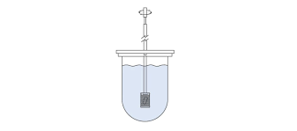
Dissolution
Dissolution of a drug particle is controlled by several physicochemical properties, including chemical form, crystal habit, particle size, solubility, surface area, and wetting properties.
When coupled with equilibrium solubility data, dissolution experiments can help to identify potential bioavailability problem areas. For example, dissolution of solvate and polymorphic forms of a drug can have a significant impact on bioavailability and drug delivery.

Slide 14
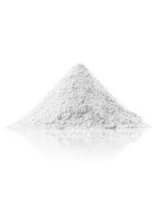
2. Bulk Characterization
In most instances, the synthetic process is developed in parallel with preformulation investigations. A drug candidate at this stage often does not has all of its solid forms identified, and there is a great potential for new polymorphs to emerge.
Bulk properties for the solid form, such as particle size, bulk density and surface morphology, are also likely to change during process development. Therefore, comprehensive characterization of all preformulation bulk lots is necessary to avoid misleading predictions of stability or solubility, which depend on a particular crystalline form.

Slide 15
Crystallinity and Polymorphism
Crystal habit and the internal structure of a drug can affect bulk and physicochemical properties, Polymorphism is the ability of a compound (or element) to crystallize as more than one distinct crystalline species with different internal lattices.
Analytical methods for characterization of solid forms:
Microscopy, Fusion methods (hot stage microscopy), Differential scanning calorimetry (DSC/DTA), Infrared spectroscopy, X-ray powder diffraction, Scanning electron microscopy, Thermogravimetric analysis, Dissolution/solubility analysis

Slide 16
Hygroscopicity
Many drug substances, particularly water-soluble salt forms, have a tendency to adsorb atmospheric moisture. Adsorption and equilibrium moisture content can depend upon the atmospheric humidity, temperature, surface area, exposure, and the mechanism of moisture uptake.
Slightly hygroscopic: Increase in weight is ≥ 0.2 % w/w and < 2 % w/w.
Hygroscopic: Increase in weight is ≥ 0.2 % w/w and <15 % w/w.
Very hygroscopic: Increase in weight is ≥ 15% w/w.
Deliquescent: Sufficient water is absorbed to form a solution.

Slide 17
Micromeritic Properties
Bulk flow, formulation homogeneity, and surface area-controlled processes such as dissolution and chemical reactivity are directly affected by micromeritic properties of solids such as size, shape, and surface morphology.
In general, each new drug candidate should be tested during pre-formulation with the smallest particle size as is practical to facilitate the preparation of homogeneous samples and maximize the drug’s surface area for interactions.
The micromeritic properties also have a significant impact on the processability and product quality of pharmaceutical dosage forms.

Slide 18
3.Stability Analysis
Pre-formulation stability studies are usually the first quantitative assessment of chemical stability of a new drug. These studies include both solution and solid-state experiments under conditions typical for the handling, formulation, storage, and administration of a drug candidate.
The major objectives of the preformulation team are, therefore, to identify conditions to which the compound is sensitive and interpret degradation profiles under these conditions. The major routes of drug degradation in solution are via hydrolysis, oxidation or photochemical reactions.

Slide 19
Solution Stability
The decomposition of a drug occurs through several pathways, i.e.
hydrolysis,
oxidation,
photolysis
racemization.

Slide 20
Solid-state Stability
The primary objectives of this investigation are identification of stable storage conditions for drug in the solid state and identification of compatible excipients for a formulation.
In general, solid-state reactions are much slower and more difficult to interpret than solution-state reactions, owing to a reduced number of molecular contacts between drug and excipient molecules and to the occurrence of multiple-phase reactions.
Once the bulk drug stability has been determined, compatibility with excipients commonly used to produce solid dosage forms must be established.

Slide 21
Drug-excipient Compatibility
The successful formulation of a stable and effective dosage form depends not only on the active pharmaceutical ingredient but also on the careful selection of excipients.
Selection of the excipients and their concentration in a formulation is based not only on their functionality, but also on the compatibility between the drug and excipients.
An incompatibility may result in changes in physical, chemical, microbiological or therapeutic properties of the dosage form.
An incompatibility in the dosage form can result in any of the following changes: Changes in organoleptic properties, Changes in dissolution performance, Physical form conversion, decrease in potency, increase in degradation products.

Slide 22


